Slide 1


Lecture 6: Query Formulation SQL Analytic Functions
Ali Chelli
Course: Business Intelligence and Data Warehousing (BID3000)

Slide 2
Outline
Processing Model and Basic Syntax
Extended Syntax and Ranking Functions
Window Aggregates I
Window Comparisons II

Slide 3
Processing Model and Basic Syntax

Slide 4
Section Objectives
Understand processing extension for analytic functions
Write SELECT statements using basic syntax elements (OVER and ORDER BY)
Reflect on the motivation for analytic function extensions
Notes:
Section 1 introduces SQL Analytic Functions with coverage of motivation, processing extensions, basic syntax, and examples.
You have three learning objectives in this lesson.
You should understand the processing extension for analytic functions, especially as the processing relates to the group by clause.
Your most important goal is to write SELECT statements using the basic syntax for analytic functions.
As a reflective goal, you should think about the importance of analytic function extensions for the SQL SELECT statement.

Slide 5
Business Intelligence Analysis
Top and worst performers
Trends
Quantitative contributions
Notes:
5
Before getting into the details of analytic functions, let's consider the motivation for extensions to the SQL SELECT statement.
Business intelligence applications typically involve analysis that combines data retrieval and computations.
Here are common types of analysis. Top and worst performers providing qualitative ranking of business units, such as store sales and item sales.
Trends identifying changes between time periods, often involving summary calculations on moving windows, such as moving averages.
Quantitative contributions showing the top or bottom percentage threshold, such 10 percent of stores by sales.

Slide 6
SELECT statement extensions
Difficult to write
Poor productivity
Poor performance
Notes:
Organizations found the SQL SELECT statement inadequate to support standard business intelligence applications.
Applications required a complex skill set involving data retrieval, procedural coding, and external tool usage.
Organizations experienced difficulties to find individuals possessing the necessary skill set.
Productivity was poor for developing business intelligence applications with complex select statements and procedural coding often required.
Performance was slow with SQL compilers often developing poorly performing plans for complex select statements.
In addition, complex calculations were typically done outside of SQL statements, so optimizing SQL compilers could not optimize both data retrieval and computations.
To overcome these deficiencies, the SELECT statement needed a major extension for both processing and specification.
The processing extension makes the analytic function extension more complex than the subtotal operator extension covered in the previous lecture.
Difficult to write
High skill level
Complex SELECT statements
Procedural coding
Poor productivity
Slow to develop BI applications
Multiple languages and tools involved
Poor performance
- Optimizing compilers cannot combine SELECT statements and procedural coding

Slide 7
Analytic Function versus Aggregate Function
Aggregate Function
Computes one value
Analytic Function
Computes multiple values
Calculated before analytic functions
Preserves number of rows in a group
Calculated after aggregate functions
Reduces group to a single row
Notes:
Analytic functions differ from aggregate functions, although both operate on groups of rows.
An analytic function computes multiple values for a group of rows, while an aggregate function computes a single value for a group of rows.
Thus, an analytic function preserves the number of rows in a group of rows, while an aggregate function reduces a group of rows to a single row.
Processing of analytic functions occurs after aggregate functions.
So a single SELECT statement can contain both aggregate functions and analytic functions.

Slide 8
Analytic Function Processing
Rows
FROM
Groups
GROUP BY
Analytic
Create partitions
WHERE
HAVING
Evaluate functions
Result
ORDER BY
Order partitions
SELECT
Notes:
The key to understanding analytic function processing is the new step after group by processing.
As you will see, the appearance of analytic functions in a SELECT statement seems to conflict with the evaluation order.
Analytic function processing occurs after row and group processing, so that calculations can be performed on group by results.
Many of the examples use grouping in analytic function processing because data warehouse retrievals often combine joins and grouping on dimension and fact tables.
Analytic function processing involves organizing group by results into partitions.
Evaluating functions over partitions, and then ordering the partitions.
Analytic function processing involves ordering as a criteria to evaluate a function, rather than ordering the final result, another confusing part of analytic functions.
Extension of SQL statement processing for analytic functions
Analytic function processing occurs after row and group processing to perform calculations of GROUP BY results
Analytic function processing involves organizing results into partitions, evaluating functions over partitions, and then ordering the partitions

Slide 9
Basic Syntax Elements
<AnalyticFunction> ([<column-list>]) OVER ( [ORDER BY <ordering>] )
Place in SELECT clause list
Ordering criteria for function evaluation
Examples
RANK() OVER
(ORDER BY ItemPrice) AS RankUnitPrice
RANK() OVER
(ORDER BY SUM(SalesDollar) ) AS RankSales
Notes:
Before examining complete SELECT statements, let's focus just on the basic syntax for analytic functions.
You place analytic functions in the SELECT list, similar to the placement of other result columns.
Syntactically, Analytic functions are indicated by an analytic function with an optional list of columns and the over keyword with an ordering.
The ordering indicates a criteria for function evaluation, not a final order in the results.
To demonstrate the syntax, let's look at two examples with a RANK function.
The rank function does not use a column list, so the empty parentheses is required.
In the first example, Ranking is computed on the item price column. The AS keyword renames the computed rank column.
In the second example, ranking occurs in the sum of sales dollar column.
The aggregate function sum indicates that a group by clause is necessary in the complete select statement, as you will see.

Slide 10
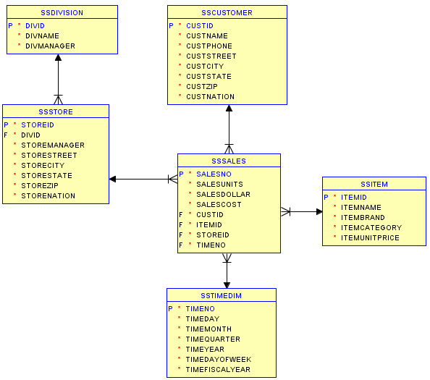
Diagram for the Store Sales Tables
Notes:
Examples in this lecture use the store sales tables.
This slide remind the details about the schema design for the DW store sales.
The DW schema has one fact table and five dimensions tables.

Slide 11
Rank Example I
Rank items by ascending item price
SELECT ItemId, ItemBrand, ItemUnitPrice,
RANK() OVER ( ORDER BY ItemUnitPrice ) AS RankUnitPrice
FROM SSItem;
ITEMID ITEMBRAND ITEMUNITPRICE RANKUNITPRICE
-------- ------------------ ------------- -------------
I1412138 Ethlite 12 1
I1445671 Intersafe 14.99 2
I6677900 Connex 25.69 3
…
Notes:
Example 1 ranks items by unit price.
In the statement, you should note the rank function with the empty parentheses, the over keyword, and the order by specification inside the over clause.
The order by clause indicates that rank is determined by ascending order of item unit price.
Sample rows indicate the values of the rank function with the smallest unit price, 12, receiving the top rank, 1.

Slide 12
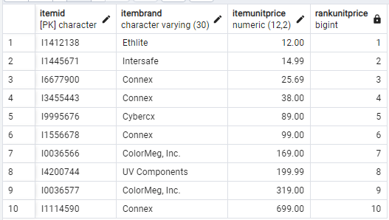
Rank Example I: Result
The result of executing the statement in Postgres is shown on the left.
The result contains 10 rows with 4 columns in each row.
Each row in the SSItem table appears in one result row.

Slide 13
Rank Example II
Rank customers by descending sum of dollar sales
Group on customer name
SELECT CustName, SUM(SalesDollar) AS SumSales,
RANK() OVER (ORDER BY SUM(SalesDollar) DESC) SalesRank
FROM SSSales, SSCustomer
WHERE SSSales.CustId = SSCustomer.CustId
GROUP BY CustName;
CUSTNAME SUMSALES SALESRANK
------------------------------ ---------- ----------
Sheri Gordon 556322 1
Wally Jones 94004 2
Jim Glussman 91100 3
Candy Kendall 90664 4
…
Notes:
Example 2 ranks customers by descending sum of dollar sales.
Because of the requirement to rank using the SUM function, a GROUP BY clause is required.
The ORDER BY specification in the OVER clause indicates that customers are ranked using the SUM function on the SalesDollar column in descending order.
Thus, the first result row with a larger sum of sales obtains a top ranking of 1.

Slide 14
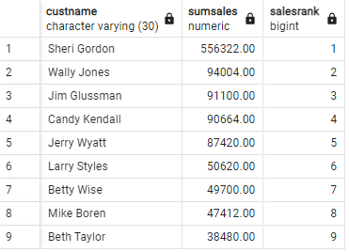
Rank Example II: Result
The result contains nine rows with three columns in each row.
The group by clause generates one customer per group and then calculates the sum of dollar sales for each customer.
The ORDER BY specification in the OVER clause indicates that customers are ranked using the SUM function on the SalesDollar column in descending order.
Thus, the first result row with a larger sum of sales obtains a top ranking of 1.

Slide 15
Additional Problems
Write SELECT statements
Example 3
Rank item brands descending by average dollar sales in 2014 and 2015
Show item brand, average dollar sales, and rank
Example 4
Rank item brands by average dollar sales in 2014 and 2015
Only include brands with more than 10 sales in 2014 and 2015
Show item brand, number of sales (COUNT), average dollar sales, and rank
Notes:
Use rank function
Grouping and non grouping

Slide 16
Section Summary
Use analytic functions to answer common business intelligence questions
Analytic functions computed after grouping
OVER and ORDER BY keywords
Notes:
This section introduced analytic functions, a substantial extension to the SQL SELECT statement in both syntax and processing.
Analytic functions support answers to common business intelligence questions involving ranking, trends, and quantitative contributions.
You learned about the evaluation order for analytic functions, and the syntax using the over and order by keywords.
Analytic functions also involve an extension of the evaluation order for the SELECT statement.
To become skilled with query formulation using analytic functions, you must understand the evaluation order, especially the evaluation of analytic functions after group by processing and ordering as a criteria in many analytic functions, such as RANK.

Slide 17
Extended Syntax and Ranking Functions

Slide 18
Section Objectives
Write statements using the PARTITIONED BY clause
Understand conceptual differences among ranking functions
Reflect about evaluation order of SELECT clauses
Notes:
Section 2 extends the introductory presentation of analytic functions from Section 1.
Section 2 covers extended syntax for partitioning and compares ranking functions useful in business intelligence applications.
You have three learning objectives in this Section.
As the primary goal, you should be ready to write select statements using partitioning.
You should understand conceptual differences among ranking functions So that you can use them appropriately.
As a reflective goal, you should think about the evaluation order of select clauses.

Slide 19
Analytic Function Processing
Rows
FROM
Groups
GROUP BY
Analytic
Create partitions
WHERE
HAVING
Evaluate functions
Result
ORDER BY
Order partitions
SELECT
Notes:
Analytic function processing occurs after row and group processing, but before final result processing
Section 1 covered analytic functions evaluated on an entire result table as a whole. Section 2 covers analytic functions evaluated on partitions of result tables.
Partitioning can be a confusing part of analytic functions.
Partitioning occurs twice in a select statement, with both a group by clause and partitioning in an analytic function.
This situation is common because analytic functions are often applied to row summaries, Created by the group by clause.
You should remember that analytic function processing occurs after group by processing, with analytic functions often evaluated on partitions of the group by results.

Slide 20
Extended Partitioning Syntax
<AnalyticFunction> ([<column-list>]) OVER ([PARTITION BY <partitioning>] [ORDER BY <ordering>] )
PARTITION BY keywords
Divides result into partitions
Analytic function evaluated for each partition
Example
RANK() OVER (
PARTITION BY CustState
ORDER BY SUM(SalesDollar) ) AS SalesRank
Notes:
Let's expand our focus to the extended syntax with partitioning.
Partition is specified by the partition keywords, followed by a list of columns, similar to the group by clause. The order and specification remains the same as in the basic syntax.
To demonstrate the syntax, let's look at a partial statement with just the analytic function part.
This example extend an example of section 1 with a partition by clause.
The rank function is evaluated on sets of rows with the same CustState (Customer State) value. The rank function values start over with each new CustState value.
For example, if there are 10 CustState values in the results before analytic function evaluation, the rank function will generate 10 different rankings.
Separate rankings will be determined for all rows with the same CustState value.
Without partition, rank computed for entire result set.
With partition, ranking computed for each customer state. Ranks reset for each state.
PARTITION BY clause indicates grouping of result set
Rows in each state are a partition
PARTITION BY is optional (square brackets);
Only use when analytic function should be calculated multiple times
Only one partition
the entire query result after grouping
No PARTITION BY keywords indicates a single partition (entire query result after grouping)

Slide 21
Ranking with Partitioning Example
Rank customers by descending sum of dollar sales
Partition ranking on customer state
SELECT CustState, CustName, SUM(SalesDollar) AS SumSales,
RANK() OVER (PARTITION BY CustState
ORDER BY SUM(SalesDollar) DESC) AS SalesRank
FROM SSSales, SSCustomer
WHERE SSSales.CustId = SSCustomer.CustId
GROUP BY CustState, CustName
ORDER BY CustState;
Note that the GROUP BY is based on 2 fields (CustState, CustName). At least 2 fields are required to do partitioning and ranking within partition (as it is the case in the code above).
Note also that within a state, you can find many customers. Therefore, we partition based on state; and within each state, we rank the customers based on SumSales.
Notes:
Example 1 extends example 2 of lesson 1 with partitioning.
Example 1 ranks customers by the sum of sales dollars with partitioning on customer state.
In the select statement, you should note the partition by keyword specification using the CustState column.
The order by keyword ensures that the results are sorted on CustState.
Within each state, the rank function ranges rows by ranking value.

Slide 22
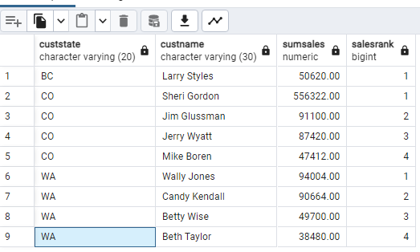
Ranking with Partitioning Example: Result
The result contains nine rows with four columns in each row.
Customers are portioned by customer state.
For each customer state, customers are ranked by sum dollar sales in descending order.
Note that the ranking restarts for each customer state.

Slide 23
Ranking Functions
RANK
DENSE_RANK
NTILE
ROW_NUMBER
Ranking gaps
No ranking gaps
Equal division
Specify divisions
Total ordering
No gaps
Golf Leaderboard
Score | RANK() | DENSE_RANK()
-10 | 1 | 1
-9 | 2 | 2
-9 | 2 | 2
-8 | 4 | 3
Notes:
There are additional ranking functions besides rank.
The dense rank function differs from the rank function on duplicate values. Rank leaves a gap on the next value after duplicates. Dense rank does not create gaps.
For example, golf leaderboards are typically reported using gaps. A leaderboard with golf scores of minus 10, minus 9, minus 9, and minus 8 would be reported with gaps, that is a rank function, as 1, 2, 2, and 4.
Without gaps, that is using the dense rank function, the leaderboard is reported as 1, 2, 2 and 3.
The n tile and row number functions are less widely used than the rank and dense rank functions.
The n tile function divides rows into equal divisions. For example, n tile 4 divides rows into 4 divisions or quartiles. Row number generates a total order of rows, with row numbers 1 to the number of rows.

Slide 24
Combined Ranking Example
Compare ranking functions
Rank customers by descending sum of unit sales
Evaluate functions on entire results (no partitioning)
SELECT CustZip, SUM(SalesUnits) AS SumSalesUnits,
RANK() OVER (ORDER BY SUM(SalesUnits) DESC) SURank,
DENSE_RANK() OVER (ORDER BY SUM(SalesUnits) DESC) SUDenseRank,
NTILE(4) OVER (ORDER BY SUM(SalesUnits) DESC) SUNTile,
ROW_NUMBER() OVER (ORDER BY SUM(SalesUnits) DESC) SURowNum
FROM SSSales, SSCustomer
WHERE SSSales.CUSTID = SSCustomer.CUSTID
GROUP BY CustZip;
Notes:
Example 2 demonstrates each ranking function to depict differences.
Each analytic function uses the same criterion, descending sum of unit sales.
The analytic functions are evaluated over the entire group by result on customer zip code.
No partitioning is specified to focus just on the analytic functions.

Slide 25
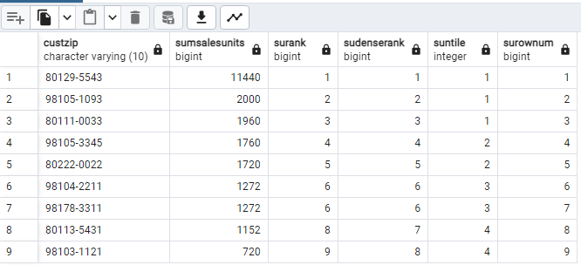
Combined Ranking Example: Result
After executing the SQL statement in Postgres, we get
The result contains nine rows with six columns in each row.
Note that rank and dense rank functions differ on the second last row.
The previous two rows have the same sum of sales value, 1, 272.
The rank function is eight, while the dense rank is seven.
Rank and dense rank differ when two rows have the same ranking value (tie). Rank () leaves gaps for following rank, while DENSE_RANK() leaves no gaps for following rank.
Notes:
Single partition
- No PARTITION BY clause
Rank and dense rank differ when two rows have the same ranking value (tie).
Rank
Leaves gaps for following rank
Boren has rank 8 after Styles and Wise have rank 6
Reporting of golf tournament results
Dense rank
No ranking gaps
Boren has rank 7 after Styles and Wise have rank 6
NTile
Tries to equally divide
9 rows into 4 groups (first group has 3 rows)

Slide 26
Combined Ranking Example: Result
After executing the SQL statement in Postgres, we get
NTILE(4) tries to equally divide 9 rows into 4 groups (first group has 3 rows)
With the first group containing the first three rows, and the other groups, two to four, containing two rows each.
The row number function generates consecutive numbers of one to nine, so that each row has a unique number in the result.
Notes:
Single partition
- No PARTITION BY clause
Rank and dense rank differ when two rows have the same ranking value (tie).
Rank
Leaves gaps for following rank
Boren has rank 8 after Styles and Wise have rank 6
Reporting of golf tournament results
Dense rank
No ranking gaps
Boren has rank 7 after Styles and Wise have rank 6
NTile
Tries to equally divide
9 rows into 4 groups (first group has 3 rows)

Slide 27
Additional Problems
Example 3
Dense rank item brands descending by the number of sales rows
Partition ranking by year
Only include brands with more than 5 sales in a year
Show item brand, year, count, and dense rank in the result
Example 4
Rank (both) item brands by descending sum of dollar sales in 2014
Partition rankings by month
Show item brand, month, sum of sales, and ranks (both)
Notes:
Include both ranking functions in example 4

Slide 28
Summary
Analytic functions evaluated over partitions
Ranking functions for qualitative evaluation
Notes:
This section extended your background about analytic functions from section 1.
You learned about extended syntax for evaluation of analytic functions over partitions using the partition by keywords.
You also learned additional ranking functions including dense rank and tile and row number.
You are encouraged to write select statements for the practice problems to apply the details of the lesson.
Examples of rank and dense_rank functions shown
Relative number
Differ on ties
Rank leaves gaps after ties
Dense_rank leaves no gaps after ties

Slide 29
Window Aggregates I

Slide 30
Section Objectives
Understand concepts and syntax for window comparisons
Write SELECT statements for window comparisons
Reflect about the importance of window comparisons
Notes:
This section extends the introductory presentations of analytic functions.
This section covers concepts and extended syntax for window comparisons.
You will learn to write select statements with physical window specifications for cumulative window calculations.
You have three learning objectives in this lesson.
Before writing statements, you need to understand window concepts and syntax.
As the primary goal, you should be ready to write select statements that perform cumulative window calculations.
As a reflective goal, you should think about the importance of query language support for window comparisons.

Slide 31
Motivation
BI applications for financial analysis and forecasting typically use window comparisons.
Window comparisons involve changes in numeric variables, such as sales or stock prices, in sets of rows known as windows.
Windows are typically defined by time intervals, such as years, months, weeks, or days.
Typical examples of window comparisons are 90 day moving average of stock prices, percentage sales growth, and cumulative sales performance for various organizational units.
SQL statement extensions to support window comparisons provides:
easier application development with a reduced skill set,
increased software development productivity,
and improved execution performance.
Notes:
Business intelligence applications for financial analysis and forecasting typically use window comparisons. Window comparisons involve changes in numeric variables, such as sales or stock prices, in sets of rows known as windows. Windows are typically defined by time intervals, such as years, months, weeks, or days.
Typical examples of window comparisons are 90 day moving average of stock prices, percentage sales growth, performance of an advertising campaign over recent months, and cumulative sales performance for various organizational units.
SQL statement extensions to support window comparisons provides easier application development with a reduced skill set, increased software development productivity, and improved execution performance.

Slide 32
Window Concepts
Before studying syntax and examples, You should understand basic window concepts.
A window is a collection of rows in which a numeric function is calculated.
A window can be specified in units of physical rows using the ROWS keyword OR logical rows using the RANGE keyword. Logical windows are specified by values, such as the number of days.
First, you will learn about physical windows. Numeric variables are calculated in moving windows. So the variables can be compared across windows.
A cumulative window is fixed on one end, typically the beginning, and changes on the other end.
A sliding window changes on both ends.
In this section, you will learn about cumulative windows.

Slide 33
Window Concepts
Units
Physical (ROWS)
Logical (RANGE)
Movement
Cumulative
Sliding
Notes:
Window: set of rows
Units:
Physical using ROWS keyword: units are rows
Logical using RANGE keyword: units are values
Movement
Cumulative: one end is fixed, typically beginning
Moving: both ends move
Windows can overlap
Only used on selected functions such as AVG, SUM, COUNT, MIN, MAX, VARIANCE, ..

Slide 34
Extended Syntax for Windows
<AnalyticFunction> ([<column-list>]) OVER ([<partitioning>] <ordering>
[<window-specification>] )
Applies to selected aggregate functions
Physical window examples
ROWS UNBOUNDED PRECEDING
ROWS 2 PRECEDING
ROWS 3 FOLLOWING
Notes:
Window specification, after ordering, is optional for analytic functions, as noted in the syntax specification.
Common aggregate functions, such as AVG for average, sum, count, min, max, and variance, can be used with a window specification. The Oracle documentation provides a complete list of aggregate functions that can be used with a window specification.
A window specification, beginning with the ROWS keyword, indicates a physical window.
For example, ROWS UNBOUNDED PRECEDING indicates a window of the current row and all preceding rows.
ROWS 2 PRECEDING indicates the current row and the two previous rows.
ROWS 3 FOLLOWING indicates the current row and the next three rows.
Logical window specifications will be presented later.

Slide 35
Cumulative Window
ROWS UNBOUNDED PRECEDING
1
2
3
4
5
6
7
8
9
10
11
12
Notes:
This diagram depicts a cumulative physical window specified as rows unbounded preceding. Initially, the window is just a single row. When processing the second row, the window is the current row, that is the second row, and the previous rows, that is the first row.
This diagram shows the window for the fifth row, comprising the current row, that is row 5, and the previous rows, that is rows 1 to 4. The arrow indicates the direction of movement from the first row towards the last physical row.
For each window, an aggregate function such as sum is calculated.
Window start is fixed. Window end moves.
For cumulative calculations, the window is typically all preceding rows
Other cumulative patterns:
Window size recedes instead of growing.
All rows for the first row.
1 row for the last row.

Slide 36
Cumulative Sum of Sales Example
Cumulative sum of dollar sales by zip code and year
No partitioning
SELECT StoreZip, TimeYear, SUM(SalesDollar) AS SumSales,
SUM(SUM(SalesDollar)) OVER
(ORDER BY StoreZip, TimeYear
ROWS UNBOUNDED PRECEDING ) AS CumSumSales
FROM SSStore, SSTimeDim, SSSales
WHERE SSSales.StoreID = SSStore.StoreId
AND SSSales.TimeNo = SSTimeDim.TimeNo
GROUP BY StoreZip, TimeYear;
Notes:
Example 1 demonstrates a cumulative physical window using the sum function.
The SELECT statement calculates the cumulative sum of dollar sales by zip code and year over the entire result without partitioning.
The WINDOW specification, Rows Unbounded Preceding, indicates a cumulative physical window. Note that the window calculations involve the sum of the sum of dollar sales.
Processing the GROUP BY clause calculates the sum of dollar sales, so analytic function processing just calculates the cumulative sum of sales. The result contains both a sum of sales and a cumulative sum of sales.
Write down purpose of statement
Calculate cumulative sales by store zip code and year
Only 1 partition
Window is all preceding rows (UNBOUNDED PRECEDING)
Analytic function for SUM of GROUP BY result (SUM(SalesDollar))
Showing only partial results: execute in Oracle
Note that sales accumulate for each row

Slide 37
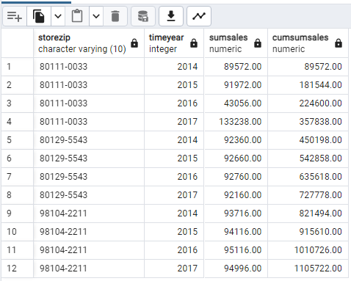
Cumulative Sum of Sales Example: Result
The result contains 12 rows, with 4 columns in each row.
Note that the last column, that is CUMESUMSALES, is calculated as the current sum of sales, plus the sum of sales in all previous rows.
Thus, the cumulative sum of sales in the second row that is 181, 544, is the sum of sales, 91, 972, plus the cumulative sum of sales in the first row, that is 89, 572.
Notes:
Write down purpose of statement
Calculate cumulative sales by store zip code and year
Only 1 partition
Window is all preceding rows (UNBOUNDED PRECEDING)
Analytic function for SUM of GROUP BY result (SUM(SalesDollar))
Showing only partial results: execute in Oracle
Note that sales accumulate for each row

Slide 38
Partitioned Cumulative Sum of Sales Example
Cumulative sum of sales by zip code and year
Partitioned by store zip
SELECT StoreZip, TimeYear, SUM(SalesDollar) AS SumSales,
SUM(SUM(SalesDollar)) OVER (PARTITION BY StoreZip
ORDER BY StoreZip, TimeYear
ROWS UNBOUNDED PRECEDING ) AS CumSumSales
FROM SSStore, SSTimeDim, SSSales
WHERE SSSales.StoreID = SSStore.StoreId
AND SSSales.TimeNo = SSTimeDim.TimeNo
GROUP BY StoreZip, TimeYear;
Notes:
Example 2 extends Example 1 with partitioning.
The SELECT statement calculates the cumulative sum of dollar sales by zip code and year over partitions of store zip code values.
The partitioning clause, with a partition by keywords, indicates that the window calculation restarts for each zip code value.
The window specification, ROWS UNBOUNDED PRECEDING, indicates a cumulative physical window.
Write down purpose of statement
Calculate cumulative sales by store zip code, year, and month
Partition by store zip code and year
Cumulative sum resets for each year
Window is all preceding rows (UNBOUNDED PRECEDING) in the partition
Showing only partial results: execute in Oracle
Note that sales accumulate for each row

Slide 39
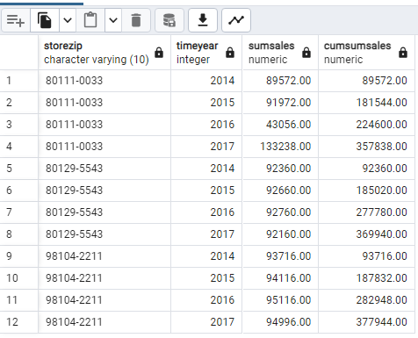
Partitioned Cumulative Sum of Sales Example: Result
The result contains 12 rows with four columns in each row.
Note that the cumulative sum of sales column restarts when the zip code changes.
For example, the zip code 80129 5543 changes in the fifth row so that the cumulative sum of sales is just the sum of sales, 92, 360, in the fifth row.
Notes:
Write down purpose of statement
Calculate cumulative sales by store zip code, year, and month
Partition by store zip code and year
Cumulative sum resets for each year
Window is all preceding rows (UNBOUNDED PRECEDING) in the partition
Showing only partial results: execute in Oracle
Note that sales accumulate for each row

Slide 40
Additional Problems
Example 3
Cumulative sum of 2014 sales by item brand and month
Partition by item brand
Show item brand, month, sum of sales, and cumulative sum of sales
Example 4
Cumulative sum of sales by year and item brand
Partition by year
Only include brands with more than 5 sales in a year
Show year, item brand, count, sum of sales, and cumulative sum of sales in the result

Slide 41
Summary
Window aggregates for common business intelligence applications
Provide increased software development productivity and improved performance
Syntax and examples for cumulative physical windows
Notes:
Many applications involve window comparisons for financial analysis and forecasting.
Window specification
ROWS for physical rows corresponding to partition ordering
RANGE for logical group of rows based on values of ordering columns
Without analytic functions in SQL
Complex combinations of SQL statements and procedural coding: advanced SQL knowledge necessary
Poor performance as compiler will not optimize

Slide 42
Window Comparisons II

Slide 43
Section Objectives
Understand concepts and syntax for sliding window comparisons
Write SELECT statements for sliding window comparisons
Reflect about the importance of window comparisons
Notes:
Let's expand our fun about analytic functions to sliding windows.
Lesson 4 continues your study of analytic functions about window comparisons begun in Lesson 3. You will learn to write SELECT statements with physical and logical window specifications for sliding window calculations. Although the coverage in this lesson is specific to Oracle SQL, other enterprise DBMSs provide similar capabilities.
You have three learning objectives in this lesson. Before writing SELECT statements, you need to understand concepts and syntax about sliding window comparisons. As the primary goal, you should be ready to write select statements that perform sliding window calculations. As a reflective goal, you should think about the importance of query language support for window comparisons.
Lesson 4 extends lesson 3 with additional Oracle analytic functions for window comparisons
Objectives:
Understand syntax for window movement (one-sided) for cumulative function calculations
Understand syntax for window movement (beginning and ending positions) for moving function calculations
Understand examples for cumulative and moving function calculations using grouping with summary functions in window comparisons

Slide 44
Window Concepts Review
Units
Physical (ROWS)
Logical (RANGE)
Movement
Cumulative
Sliding
Notes:
Section 3 covered concepts and examples for cumulative physical windows specified with the ROWS keyword.
This lesson covers sliding windows, both physical and logical.
Logical windows, indicated by the range keyword, are specified for an ordering variable such as a shipment date or a number of years.
The range values indicate starting and ending points of a window.
Sliding windows, also known as moving windows, change on both ends.
Window: set of rows
This lesson focuses on sliding windows with coverage of both physical and logical units.
Units:
Physical using ROWS keyword: units are rows
Logical using RANGE keyword: units are values
Movement
Cumulative: one end is fixed, typically beginning
Sliding (Moving): both ends move
Windows can overlap
Only used on selected functions such as AVG, SUM, COUNT, MIN, MAX, VARIANCE, ..

Slide 45
Logical Window Examples
Partial example 1
ORDER BY TimeYear
RANGE UNBOUNDED PRECEDING
Partial example 2
ORDER BY HireDate
RANGE 90 PRECEDING
Partial example 3
ORDER BY ShipDate
RANGE BETWEEN 365 PRECEDING AND 365 FOLLOWING
Partial example 4
ORDER BY ShipDate
RANGE BETWEEN INTERVAL '1' YEAR PRECEDING AND
INTERVAL '1' YEAR FOLLOWING
Notes:
To clarify logical window concepts, let's consider some partial examples.
These partial examples show the ordering column and the logical window specification, because a logical window specification cannot really be understood without knowing the ordering column. Logical windows require additive columns, typically columns with a date data type.
The first partial example indicates a cumulative window containing the current row and rows with all previous values of time year.
Range Unbounded Preceding differs from Rows Unbounded Preceding when the current row has the same ordering column value as the next row.
For Range Unbounded Preceding, the next row is included in the window, while the next row is not included for Rows Unbounded Preceding.
The second partial example defines a sliding logical window. The window specification Range 90 preceding indicates the current row and rows with higher date in the previous 90 days. For columns with a date data type, the default interval is days.
The third partial example defines a centered sliding logical window. The window specification range between 365 preceding and 365 following includes the current row, rows within the previous 365 days of ship date in the current row, and rows within the next 365 days of the current row.
The fourth partial example uses the interval keyword to specify a centered sliding logical window.
The window specification in Examples 3 differ only for leap years. Interval values must be entered as a text value with an integer inside single quotation marks. The ordering column must have a date data type. When using the interval keyword. Intervals can also be specified using the month and day keywords.

Slide 46
Sliding, Centered Physical Window
ROWS BETWEEN 1 PRECEDING AND 1 FOLLOWING
Row
Window Boundaries
1
Current Row | Window Start | Window End
1 | 1 | 2
2 | 1 | 3
3 | 2 | 4
4 | 3 | 5
5 | 4 | 6
6 | 5 | 7
7 | 6 | 8
8 | 7 | 9
9 | 8 | 10
10 | 9 | 11
11 | 10 | 11
2
3
4
5
6
7
8
9
10
11
Notes:
This diagram depicts a sliding, physically centered window, specified as rows between one preceding and one following.
In the diagram, you should note the window for the fifth row, comprising the current row, that is row 5, the previous row, row 4, and the next row, row 6.
The arrows indicate the forward direction of movement for both the start and end of the window.
For each window, an aggregate function such as AVG for average is calculated.
As a more complete reference, the windows boundary table shows the starting and ending rows of the window for each current row. Note that the windows for the first and last rows contain only two rows.
Window start and end move
Flexible ways to define start and end
Window does not have to be centered on the current row.
Windows can overlap
For time period calculations, windows are typically centered with the current row in the middle position.

Slide 47
Sliding Physical Window Example
Moving average of sum of sales by zip code and year
Centered physical window of 3 rows
No partitioning
SELECT StoreZip, TimeYear, SUM(SalesDollar) AS SumSales,
AVG(SUM(SalesDollar)) OVER
(ORDER BY StoreZip, TimeYear
ROWS BETWEEN 1 PRECEDING AND 1 FOLLOWING) AS CenterMovAvgSumSales
FROM SSStore, SSTimeDim, SSSales
WHERE SSSales.StoreID = SSStore.StoreId
AND SSSales.TimeNo = SSTimeDim.TimeNo
GROUP BY StoreZip, TimeYear;
Notes:
Example 1 demonstrates a select statement for a sliding physical window using the AVG function.
The SELECT statement calculates the average of the sum of dollar sales by zip code and year over the entire result without partitioning. The window specification, rows between one preceding and one following, indicates a sliding, physically centered window.
-- Moving average of sum of dollar sales ordered by store zip code and year
-- Window is centered between preceding and following rows including the current row.
-- No partitioing
-- Physical window specifications (ROWS)

Slide 48
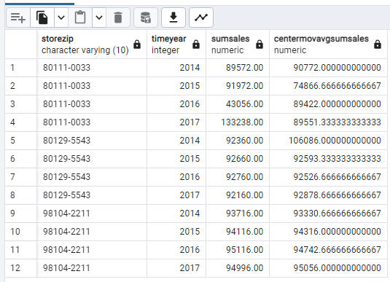
Sliding Physical Window Example: Result
The result contains 12 rows, with four columns in each row.
Note that the moving average in the first row, 90, 772, is the average of the sum of sales in row 1 (89, 572) and row 2 (91, 972).
Likewise, the moving average in the last row, 95, 056, is the average of the sum of sales in the last two rows.
The moving average in the other rows involves three rows, the current row, previous row, and next row.
Notes:
-- Moving average of sum of dollar sales ordered by store zip code and year
-- Window is centered between preceding and following rows including the current row.
-- No partitioing
-- Physical window specifications (ROWS)

Slide 49
Sliding, Centered Logical Window
RANGE BETWEEN 1 PRECEDING AND 1 FOLLOWING
Row ShipDate
Window Boundaries
1 11/2/2015
Current Row | Window Start | Window End
1 | 1 | 2
2 | 1 | 3
3 | 2 | 4
4 | 3 | 5
5 | 4 | 7
6 | 5 | 7
7 | 5 | 7
8 | 8 | 10
9 | 8 | 10
10 | 8 | 10
11 | 11 | 11
2 11/3/2015
3 11/4/2015
4 11/5/2015
5 11/6/2015
6 11/7/2015
7 11/7/2015
8 11/9/2015
9 11/9/2015
10 11/10/2015
11 11/12/2015
Notes:
This diagram depicts a sliding, logically centered window specified as range between one preceding and one following. This diagram shows the window for the fifth row with ship date 11 6 2015. The current row, row 5, Row 4 with the previous date of 11 5 2015, and rows 6 and 7 with the next date 11 7 2015.
As a more complete reference, the window boundaries table shows the starting and ending rows in the window for each current row. With duplicate and or missing values, a centered logical window may not be physically centered. For example, the window shown in this diagram is not physically centered on the current row, with starting row 4 and ending row 7.
You should study the window boundaries to see other examples of logically centered windows that are not physically centered.
Assumes ORDER BY column is date data type such as hire date
Multiple rows with the same date
Logically centered but not necessarily physically centered
Multiple rows with the same date (11/7/2015)
Gaps in rows with dates (no rows on 11/8/2015 or 11/11/2015)
Sliding window for current row on 11/9/2015: current row (no previous row) and row on 11/10/2015

Slide 50
Sliding Logical Window Example
Moving average of sum of dollar sales by year
Centered logical window of 3 years
No partitioning
SELECT TimeYear, SUM(SalesDollar) AS SumSales,
AVG(SUM(SalesDollar)) OVER
(ORDER BY TimeYear
RANGE BETWEEN 1 PRECEDING AND 1 FOLLOWING) AS CenterMovAvgSumSales
FROM SSStore, SSTimeDim, SSSales
WHERE SSSales.StoreID = SSStore.StoreId
AND SSSales.TimeNo = SSTimeDim.TimeNo
GROUP BY TimeYear;
Notes:
Example 2 demonstrates a SELECT statement for a sliding, logically centered window using the AVG function. The SELECT statement calculates the average of sum of dollar sales by year without partitioning.
The window specification, ranged between one preceding and one following, indicates a sliding, logically centered window.
-- Moving average of dollar sales ordered by year
-- Window is centered between preceding and following years including the current row.
-- Logical window specifications (RANGE)
-- No partitioning
-- ordering column must be additive when using logical window
Results
- No gaps in years so logical is the same as physical

Slide 51
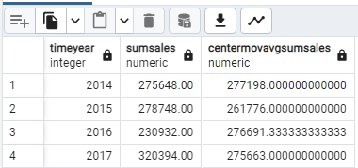
Sliding Logical Window Example: Result
The result contains four rows with three columns in each row. Note that the moving average in the first row 277, 198 is the average of the sum of sales in rows one and two.
Likewise, the moving average in the last row 275, 663 is the average of the sum of sales in the last two rows.
The moving average in the other rows involves three rows, the current row, previous row, and next row, since the ordering column, time year, has no duplicate or missing values.
Notes:
-- Moving average of dollar sales ordered by year
-- Window is centered between preceding and following years including the current row.
-- Logical window specifications (RANGE)
-- No partitioning
-- ordering column must be additive when using logical window
Results
- No gaps in years so logical is the same as physical

Slide 52
Additional Problems I
Example 3
Moving average of sum of sales by year and item brand
Partition by year
Centered window on 2 preceding and 2 following rows
Only include brands with more than 5 sales in a year
Show year, item brand, count, sum of sales, and average sum of sales in the result
Example 4
Moving average of sum of 2014 dollar sales by month
Centered window on 3 preceding and 3 following months
Show month, sum of sales, and average of sum of sales
Notes:
Solutions in a module 3 document

Slide 53
Summary
Sliding window aggregates for common business intelligence applications
Syntax for specifications of logical sliding windows
Examples for physical and logical sliding windows
Notes:
Many applications involve window comparisons for financial analysis and forecasting.
Window specification
ROWS for physical rows corresponding to partition ordering
RANGE for logical group of rows based on values of ordering columns
Without analytic functions in SQL
Complex combinations of SQL statements and procedural coding: advanced SQL knowledge necessary
Poor performance as compiler will not optimize

